Slide 1
ARMv8상에서 Classic McEliece의 Multiplication and Inversion operation 구현
https://youtu.be/g43mKHFng94

Slide 2
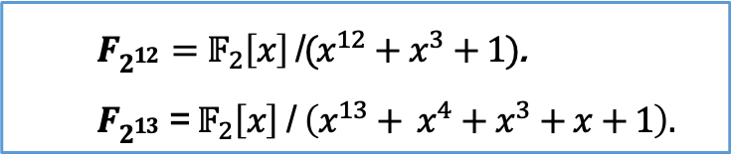

Classic McEliece
NIST PQC 4라운드 후보군 중 유일한 코드기반 암호
Key generation, Encapsulation, Decapsulation 3단계 수행
Extended binary finite-filed $F_{2^{m}}$ 상의 Multiplication 과 Inversion 연산
Public keygen : inverse + multiplication on $F_{2^{m}}$
Secret keygen : inverse + multiplication on $F_{2^{m}}$
Encap : X
Decap : inverse + multiplication on $F_{2^{m}}$
$F_{2^{12}}=𝔽_{2}\left[x\right]$/$(x^{12}+x^{3}+1)$.
$F_{2^{13}}$ = $𝔽_{2}\left[x\right]$ / $\left(x^{13}+ x^{4}+x^{3}+x+1\right).$
Algorithm | m | n | t | level | Public key | Secret key | Ciphertext
Mceliece 348864 | 12 | 3488 | 64 | 1 | 261,120 | 6,492 | 128
Mceliece 460896 | 13 | 4608 | 86 | 3 | 524,160 | 13,608 | 188
Mceliece 6688128 | 13 | 6688 | 128 | 5 | 1,044,992 | 13,932 | 240
Mceliece 6960119 | 13 | 6960 | 119 | 5 | 1,047,319 | 13,948 | 226
Mceliece 8192128 | 13 | 8192 | 128 | 5 | 1,357,824 | 14,120 | 240
Parameters of Classic McEliece

Slide 3
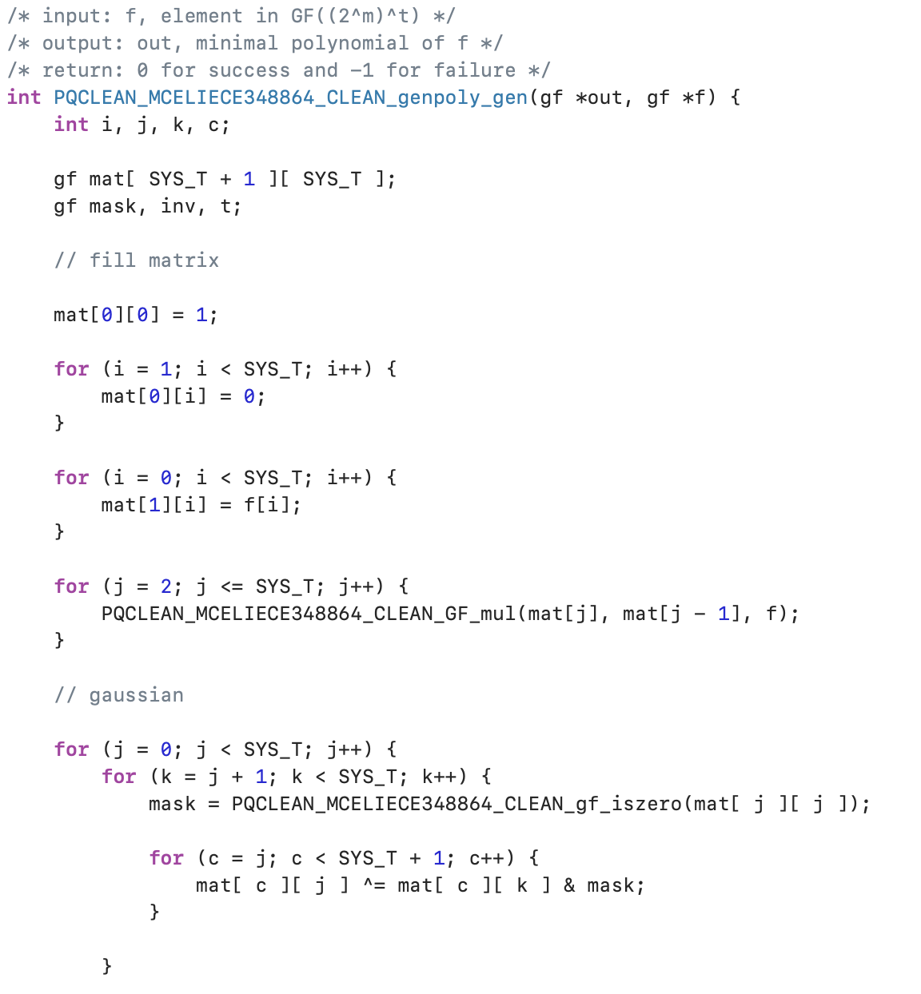
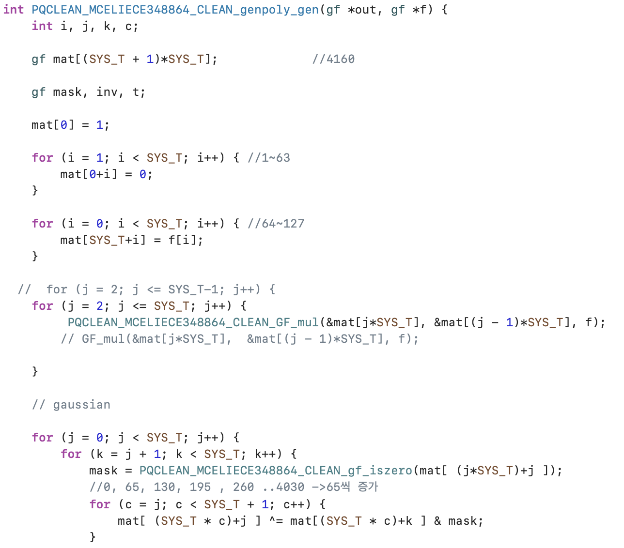
Multiplication
Secret key gen의 일부

Slide 4
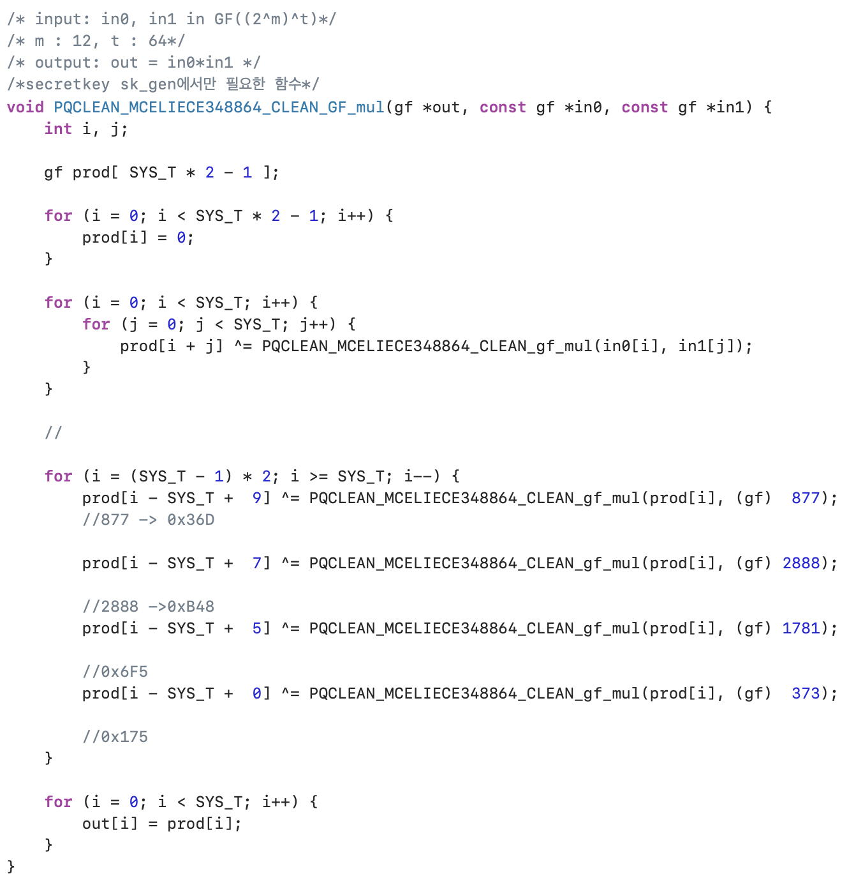
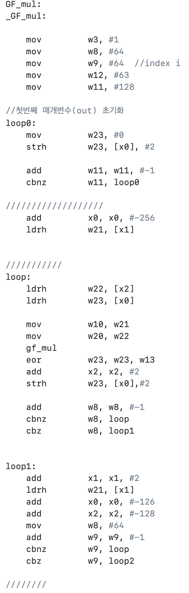
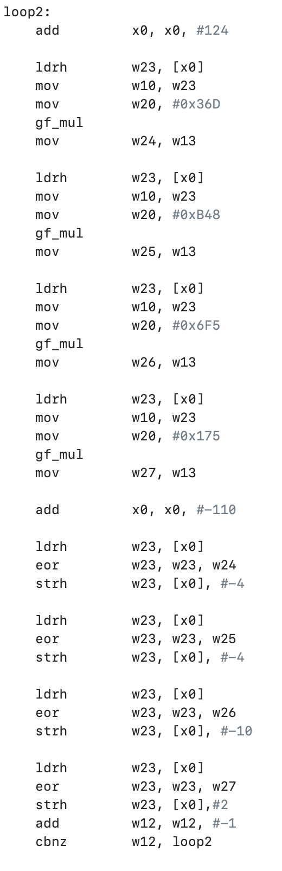
Multiplication

Slide 5
Multiplication

Slide 6
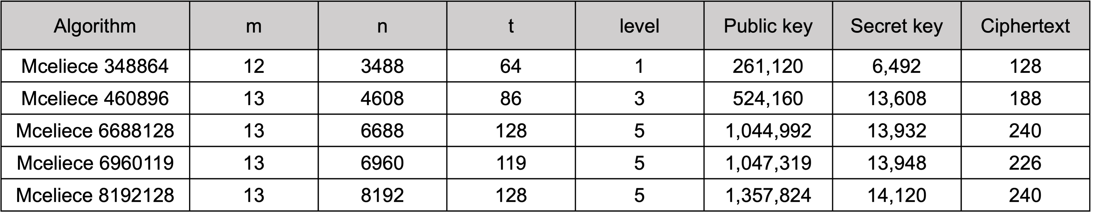
Multiplication

Slide 7
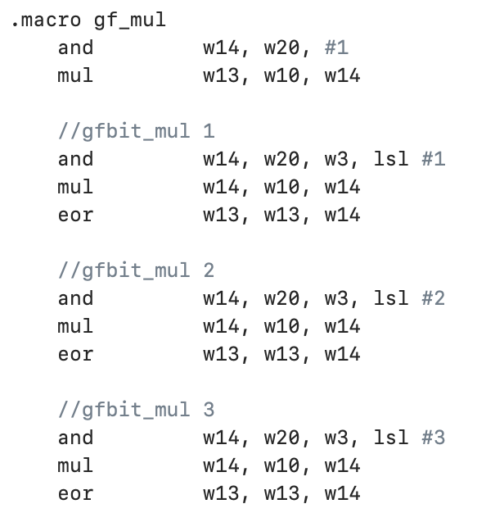
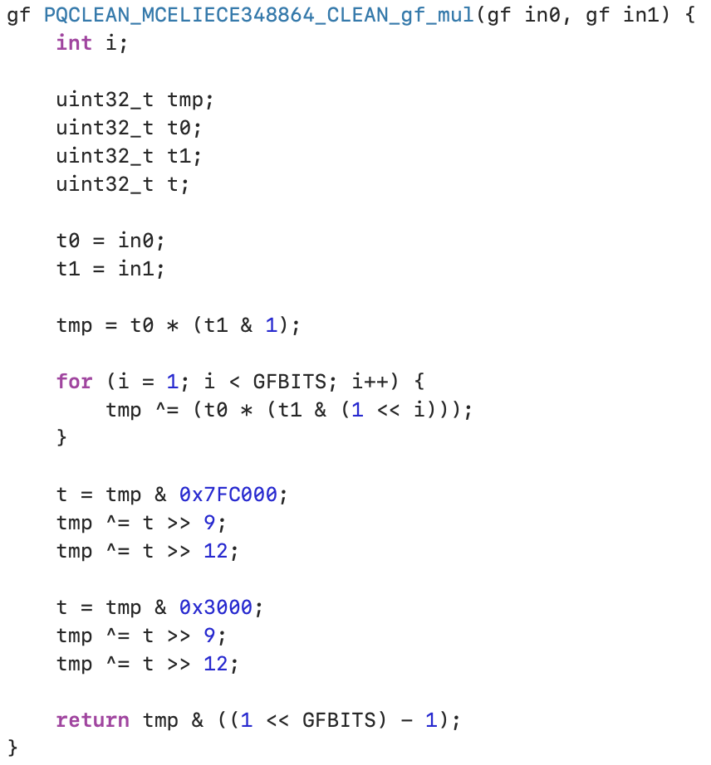
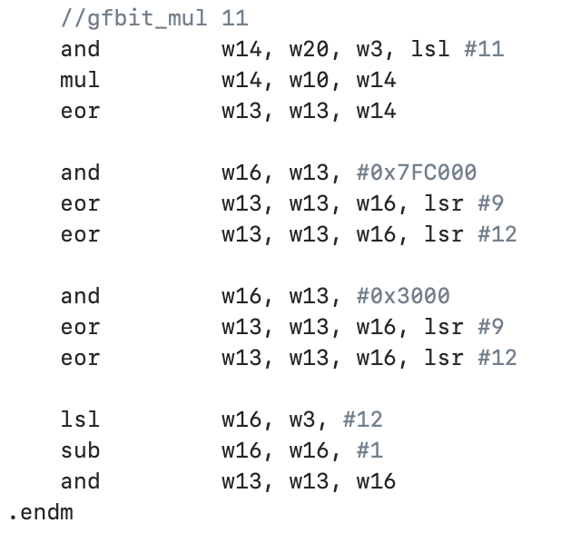

Multiplication
$$⋮$$

Slide 8
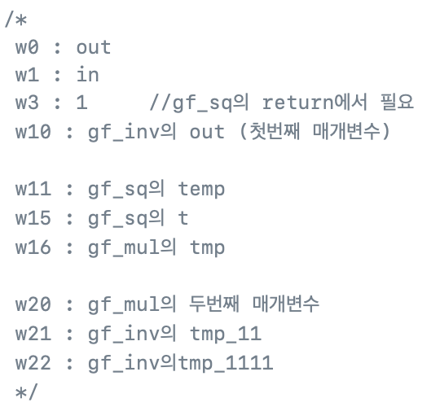
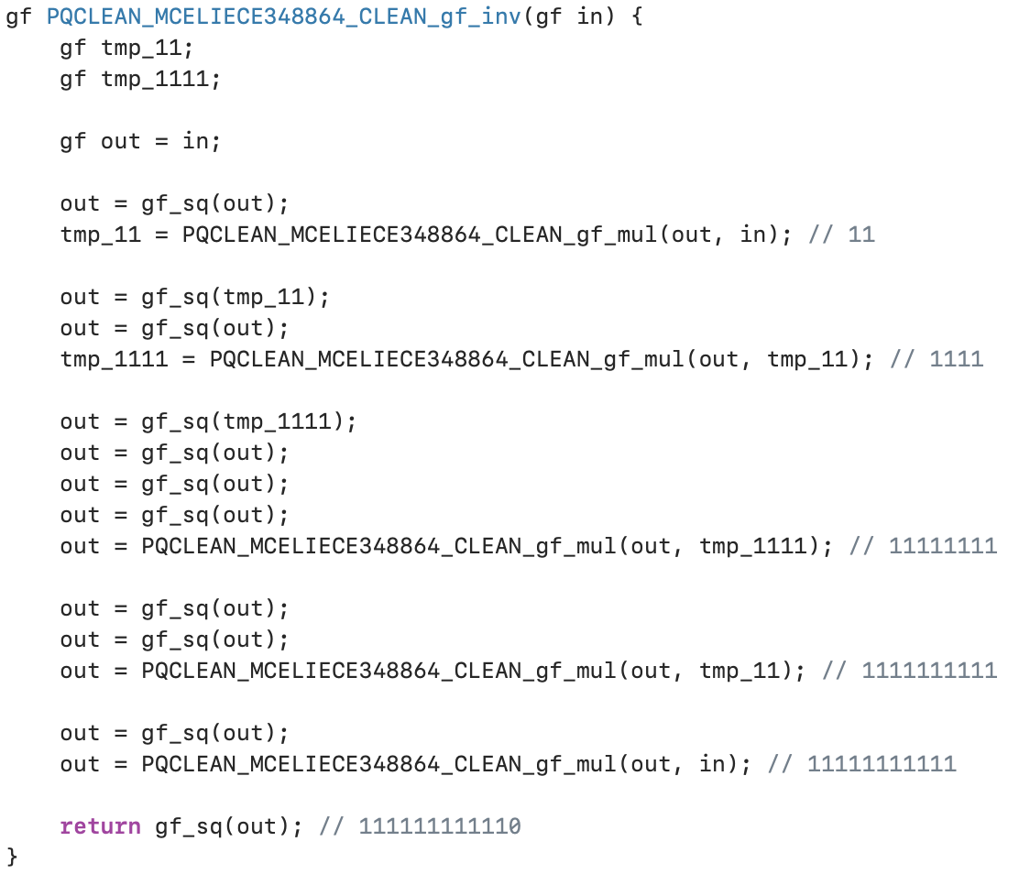
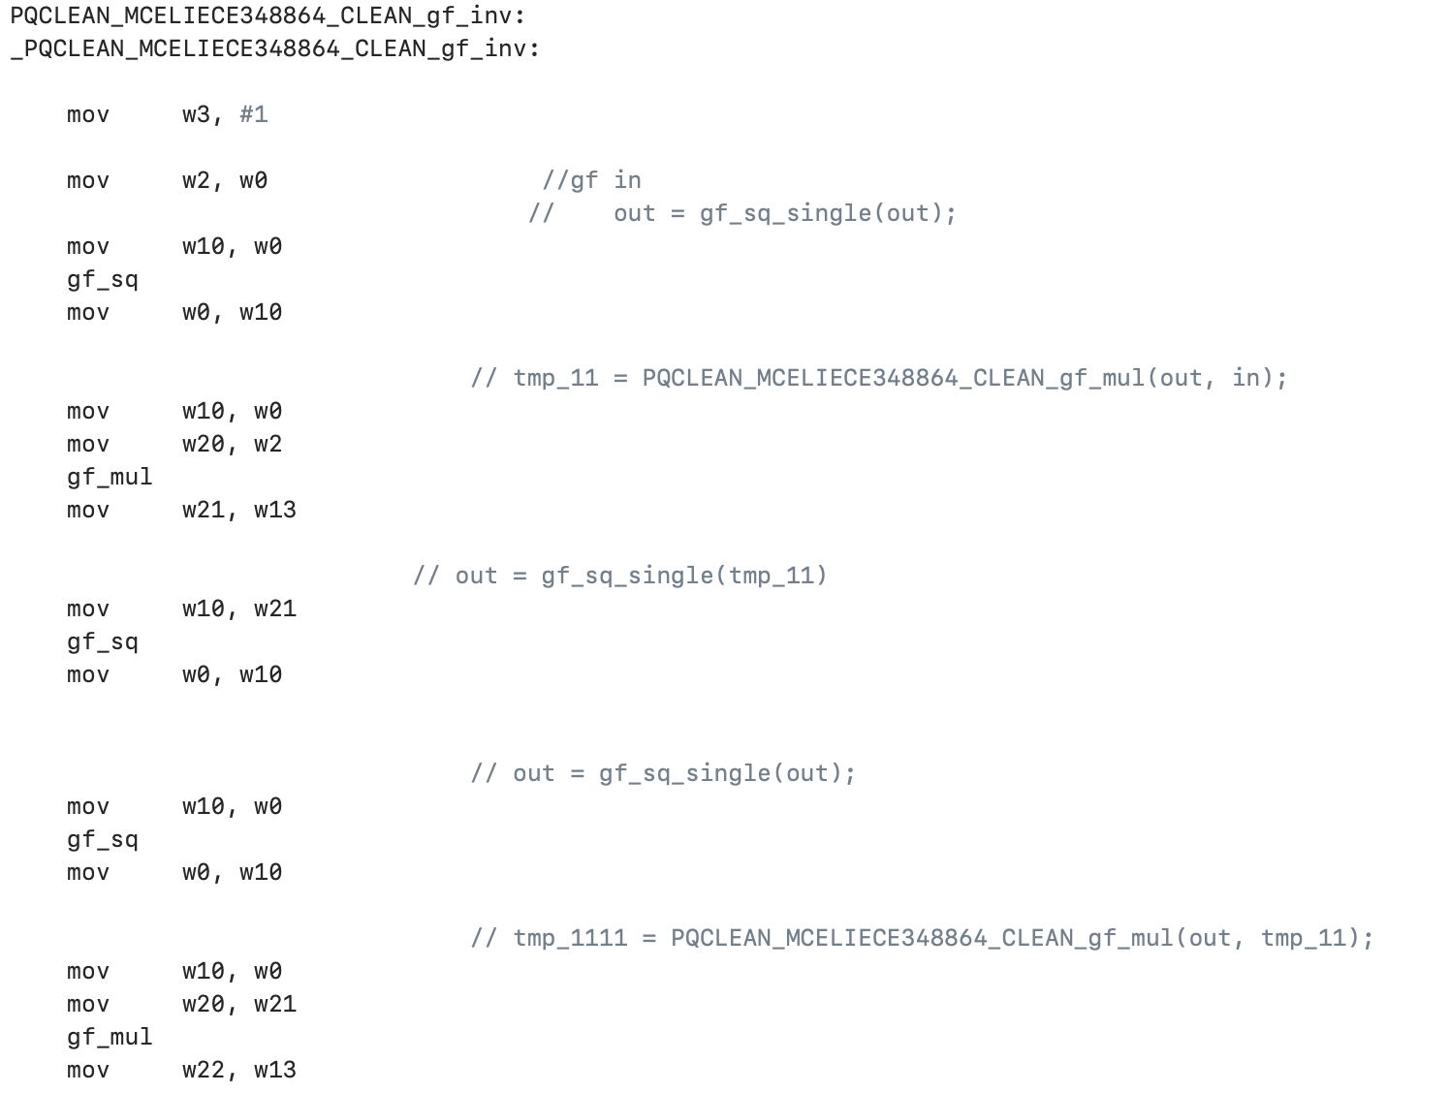
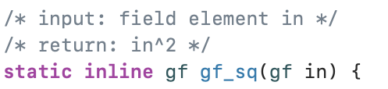
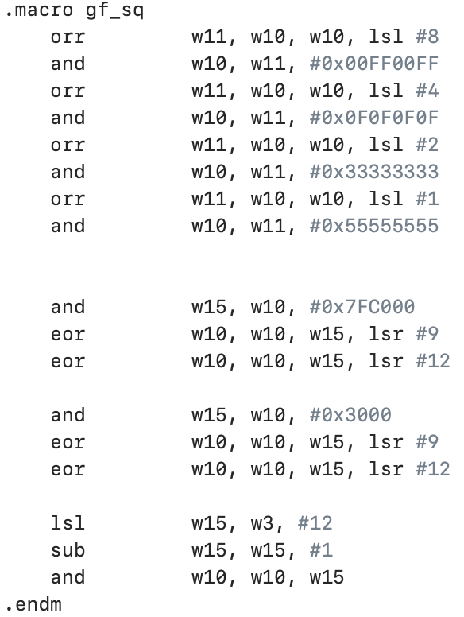
Inversion
Inversion 연산
Squaring 연산과 Multiplication 연산

